Slide 1
Business Profile Assignment (BPA) Instructions
You will use this deck for this template for this week’s assignment. You will turn in this PowerPoint file as your homework submission. With each subsequent assignment, please include the “Student Name” and “Business Profile – Overview” slides with your submission. Here are some points to remember when using this template:
You must use the same company for all assignments. Preferably, this is the company you currently work for. However, if you are not working at the moment, or your company just doesn’t work well for these assignments (i.e. government agencies, small volunteer organizations) then select a company in an industry that interests you or that you would like to work for.
These assignments are built around the company you work for to maximize your ability to apply the content to a familiar context. However, it’s a challenge for ICs that may not be as familiar with your organization. Provide additional detail, additional notes, or anything else that can help your IC grade the assignment either in slide notes or in additional slides.
There are notes on each slide indicating which assignment that slide is a part of to make it easy for you to know when each slide needs to be completed. The slide notes may also contain additional instructions – make sure you read them!
If additional space is necessary, you may insert additional slides and/or use the notes option, just make it clear to your IC that the content is continued on the next slide.
FILE NAMING
Please follow the file naming convention below. This helps your IC find your assignment easily: LASTNAME.FIRSTNAME.ASSIGNMENTNAME. Example: PORTER.MICHAEL.BPA

Slide 2
Assignment Grading Criteria
Evaluation Criteria (from Course Syllabus)
Support Quality of Work:
Each statement or explanation is supported by sound facts, logics, or data points.
Analysis yields complex and nuanced syntheses of ideas, demonstrating true understanding.
Accurate Class Concept Use:
Class concepts are used throughout the assignment in a manner that demonstrates a full understanding of the concept.
Critical Thinking:
Exercises include data and reasoning that confirms or disconfirms the thesis.
The analysis or explanation demonstrates an understanding of the uncertainty surrounding the facts, logics, and conclusions.
Mechanics and Professionalism:
Work is professionally presented and free from grammatical or typographical errors.
Headings, images, figures, and tables are appropriately and effectively used.
WOW Factor:
Approximately 10% of the total grade will be determined by the WOW factor. This is evidence of work that exceeds expectations. These points are reserved for those projects that go beyond assignment requirements and demonstrate creativity, extra effort, and refined professionalism.
Business Profile Assignment Rubric
Criteria | Pts
Business Profile What’s your elevator pitch? Be sure you provide sufficient detail for your IC to understand your business. | 10 pts
Organization Structure Provide company organizational structure. Explain how your company is organized: is it a hierarchical organization? Flat organization? Does the organizational structure facilitate meeting your objectives? Why? Which functional areas are key to your organization’s success and why? | 35 pts
Stakeholders Who are some of the key stakeholders for your company? What are ways that they influence your organization? What are some examples of how they are critical to your organization’s success? | 35 pts
Total Points: 80

Slide 3

Student Name
Insert student name here
(Please use the name you prefer your IC use for communication with you)
Student photo

Slide 4
Business Profile – Overview
Business name:
Business website:
Products/services:
Target market(s)/customers:
Top rivals/competitors:
Notes:
Complete this slide with the Business Profile assignment. (Make sure you completed the title page of this template as well)

Slide 5
Business Profile – Description
Describe your business – what’s your elevator pitch? Be sure you provide sufficient detail for your IC to understand your business.
Notes:
Complete this slide with the Business Profile assignment.

Slide 6
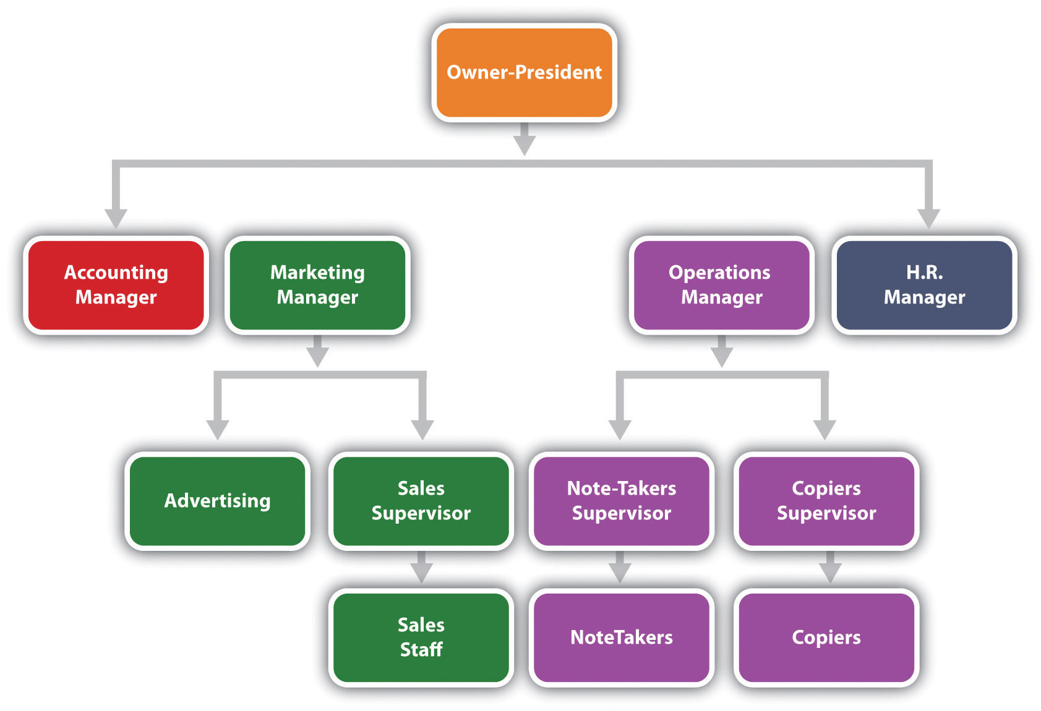
Business Profile – Organization Struture
Replace the organization chart on this slide with one that describes your company’s structure.
Explain how your company is organized: is it a hierarchical organization? Flat organization?
Does the organizational structure facilitate meeting your objectives? Why?
Which functional areas are key to your organization’s success and why?
NOTE: The graphic can take the entire slide, and you can use the Slide Notes below to address the questions and provide explanations. You can also create additional slides if necessary.
Notes:
Complete this slide with the Business Profile assignment.

Slide 7
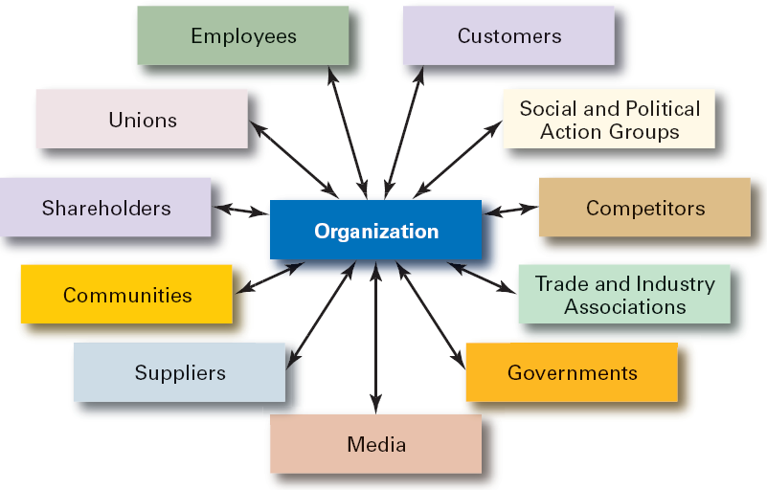
Business Profile – Organizational Stakeholders
Replace the graphic on this slide with one that names your company’s key stakeholders.
Who are some of the key stakeholders for your company?
What are ways that they influence your organization?
What are some examples of how they are critical to your organization’s success?
NOTE: The graphic can take the entire slide, and you can use the Slide Notes below to address the questions and provide explanations. You can also create additional slides if necessary.
Notes:
Complete this slide with the Business Profile assignment.

